Slide 1
Most Popular Superhero

Slide 2
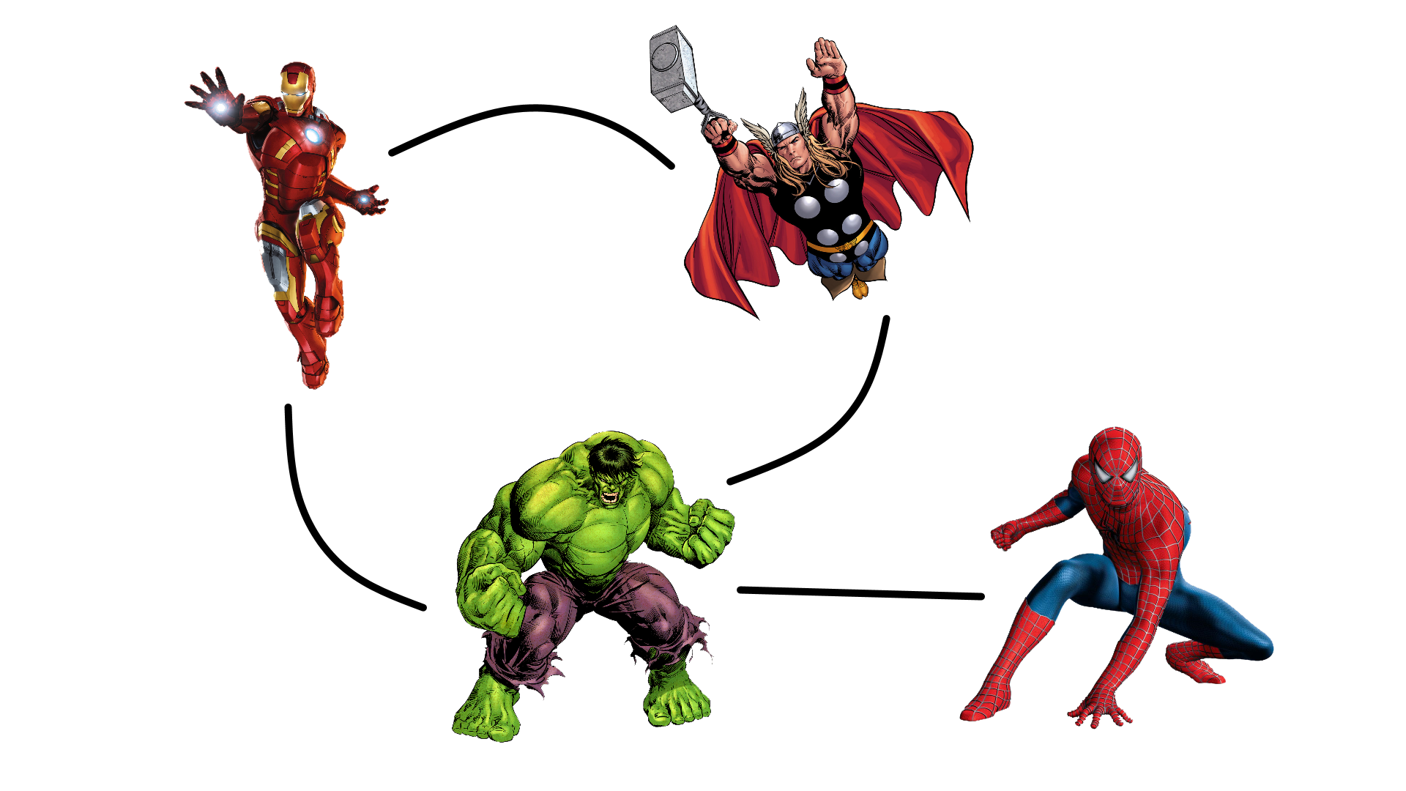
Superhero social networks

Slide 3
Input data format
Marvel-graph.txt:
4395 2237 1767 472 4997 5931 6235 1478 1369 806 3994 6232
3519 4704 2460 763 1602 5306 5358 6121 6160 2459 3173 4963 6166
3518 5409
A hero may span multiple lines!
Marvel-names.txt:
5300 "SPENCER, TRACY"
5301 "SPERZEL, ANTON"
5302 "SPETSBURO, GEN. YURI"
5303 "SPHINX"
5304 "SPHINX II"
5305 "SPHINX III"
5306 "SPIDER-MAN/PETER PAR"
5307 "SPIDER-MAN III/MARTH"
5308 "SPIDER-MAN CLONE/BEN"
5309 "SPIDER-WOMAN/JESSICA"

Slide 4
Most popular superhero: strategy
Map input data to (heroID, number of co-occurrences) per line
Add up co-occurrence by heroID using reduceByKey()
Flip (map) RDD to (number, heroID) so we can..
Use max() on the RDD to find the hero with the most co-occurrences
Look up the name of the winner and display the result

Slide 5
Off to the code…

Slide 6

And the winner is…

